Slide 1
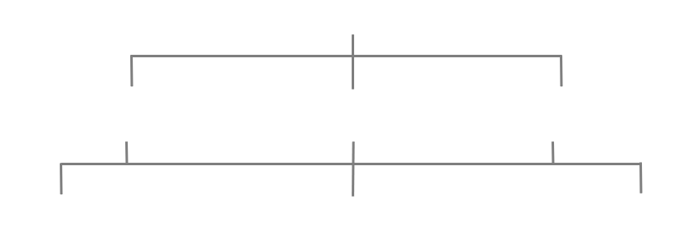
Functional Structure
Deputy Minister
ADM Programs
ADM Corporate Services
ADM Policy
Director General
Human Resources
Director General
Finance
Director General
Administration

Slide 2

Decentralized Structure
Deputy Minister
West Region
Central Region
East Region
HQ Corporate Services
Quality and Reporting
Operations
Corporate Services

Slide 3
OC Structure
Mandate and budget
Organizational Design
Analysis – Job description
Job Evaluation - Classification
Terms and Conditions of Employment
Resourcing
Performance Management

